Slide 1
Consent and the Law
I can explain what consent in relationships means.
I can explain what sexual consent is.
I am building understanding, skills and capacity to assert myself in relationships so that I can express what I want and don’t want.
I have an understanding of the law on sexual offences/sexual consent.

Slide 2
Screwball
(duration 12 minutes 22 seconds) https://www.truetube.co.uk/film/screwball

Slide 3
Being and feeling safe…
If you are in a relationship, you have the right to be healthy, happy and safe. Thinking about what it means to be safe in a relationship, what does this mean in practice?
Being safe means that….

Slide 4
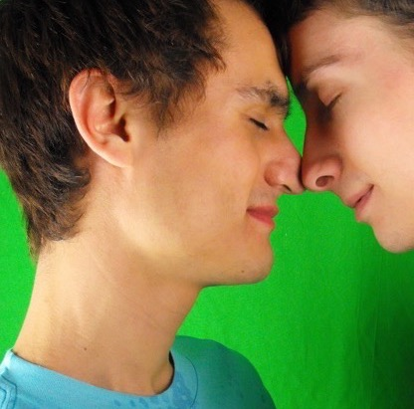
You and your partner treat each other with respect.

Slide 5
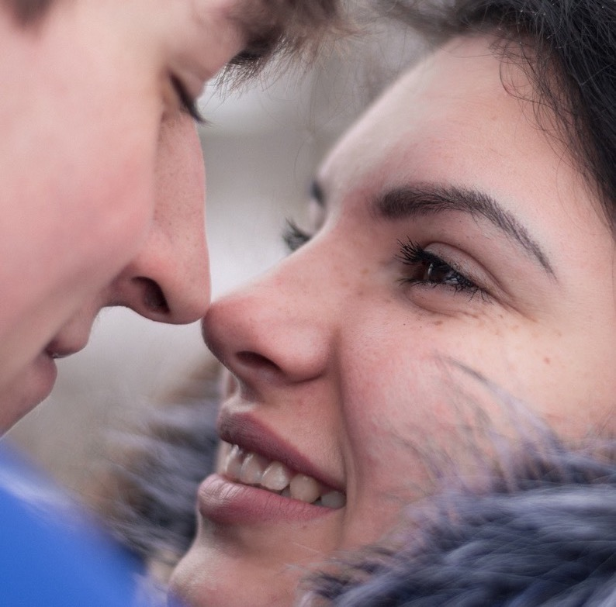
You care about each other.

Slide 6
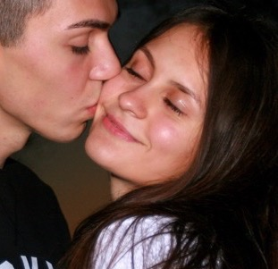
There is never any pressure put on you to do something that makes you feel uncomfortable, worried or scared, and you never put pressure on your partner to do something that makes them feel, uncomfortable, worried or scared.

Slide 7
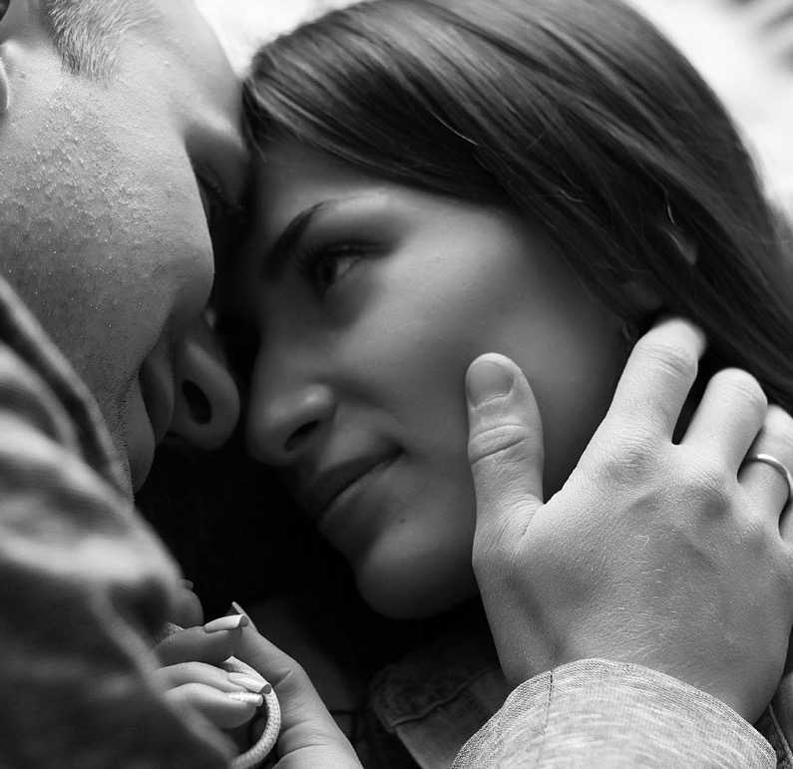
You never do anything sexual when you don’t want to or make anyone else do something sexual when they don’t want to.

Slide 8
You never feel any pressure to take or send or look at images or messages that are nude or sexual, and you don’t put pressure on someone else to do this.

Slide 9
You don’t have to spend time with your partner if you don’t want to. You can keep your friends and see them when you want to.

Slide 10
How do you know if someone wants to have sex with you?

Slide 11
Film: How do you know if someone wants to have sex with you?
https://youtu.be/qNN3nAevQKY
(Duration: 3 minutes 50 seconds)

Slide 12
Sexual consent and the law
If you are doing anything sexual with another person then you must be sure they are happy and freely agreeing to the sexual activity. This is called giving consent.
Sexual activity includes:
Touching each other’s bodies, including genitals (your private parts)
Penetrative sex, this is when a person puts their fingers or penis or something else into a person’s mouth, vagina or anus (bottom).

Slide 13
There are laws that protect us from harmful sexual behaviour, abuse and exploitation. An important law is the Sexual Offences (Scotland) Act 2009. The law protects us all against these things:
Rape
Sexual assault
Coercing a person in to being present during a sexual activity
Coercing a person into looking at a sexual image
Communicating indecently
Sexual exposure
Voyeurism
Administering a substance for sexual purposes.

Slide 14
The Sexual Offences (Scotland) Act 2009 now includes ‘Up-skirting’ in the Voyeurism section.

Slide 15
Activity: 10 facts about consent.

Slide 16
No consent = No Fairy Tale https://youtu.be/QJTqpydWFNA

Slide 17
INSERT LOCAL INFORMATION ABOUT SEXUAL HEALTH OR OTHER CONFIDENTIAL INFORMATION/SUPPORT SERVICES HERE

Slide 18
Cycling through Consent
https://youtu.be/-JwlKjRaUaw
Consent – cup of tea
https://youtu.be/u7Nii5w2FaI

