Slide 1
Menstruation
I can name parts of my body.
I can talk about the different parts of my body and what they do.
I can describe the changes that take place with puberty.
I know and can describe how to prepare for and manage periods and I am aware of all the available options, including re-usable products.
I understand how to maintain personal hygiene.

Slide 2
Menstruation: What to expect (duration 3 minutes 18) https://youtu.be/DBe7-PHRav8
Period hygiene: Tampons, Pads and Menstrual Cups (duration 2 minutes 9) https://youtu.be/kmWbOC8Fbb0

Slide 3
Menstruation:
What is Normal?
This activity ©Hey Girls CIC 2019. Reproduced with kind permission of the owner.

Slide 4
Medical conditions associated with menstruation
Endometriosis – affects 1 in 10 women in the UK and causes chronic pain. Adenomyosis and Fibroids also cause severe menstrual pain
Menorrhagia - very heavy menstrual bleeding
Pre-menstrual dysphoric disorder (PMDD) – a particularly severe and distressing form of pre-menstrual syndrome (PMS). Mood symptoms are very pronounced, and can include anxiety, depression, irritability, severe mood swings, difficulty concentrating and fatigue
Polycystic ovarian syndrome (PCOS) – can cause very irregular periods, excess facial or body hair, acne and weight gain, along with irregular or missing ovulation

Slide 5
If periods have a significant negative impact on someone’s life then there is something wrong. Information, help and support is available.

Slide 6
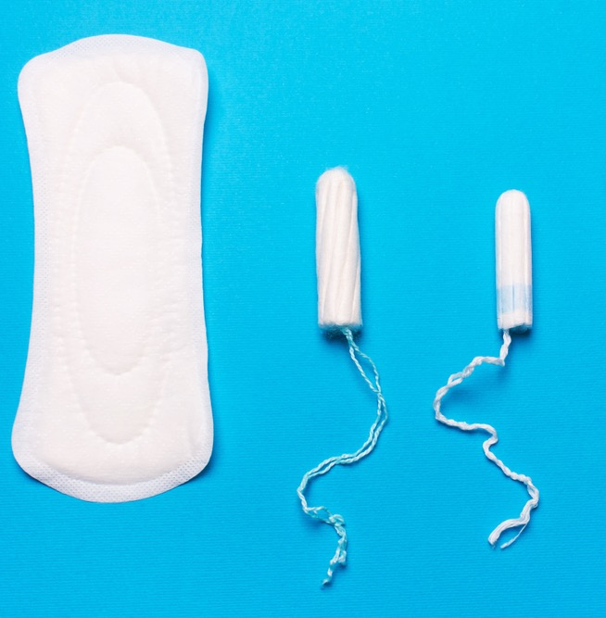
Menstrual products
Disposable pads, tampons (applicator and non-applicator), Menstrual Cups, Reusable (cloth) pads and Period pants.

Slide 7
Toxic Shock Syndrome is a rare but serious illness that you can get if you leave a tampon in for a long time. Always use the lightest absorbency for your flow and change tampons every 4-6 hours (maximum 8 hours). If you have a fever and think you might have toxic shock, go to the doctor
Never flush period products down the toilet. Always put them in a bin

