Slide 1
Getting to know your body: Self-examination/Sexual Problems
I can undertake a self-examination of breasts/testicles.
I am aware of common sexual problems.
I know how to find and to access sexual health services.

Slide 2

What have you heard about self-examination of breasts or testicles?

Slide 3
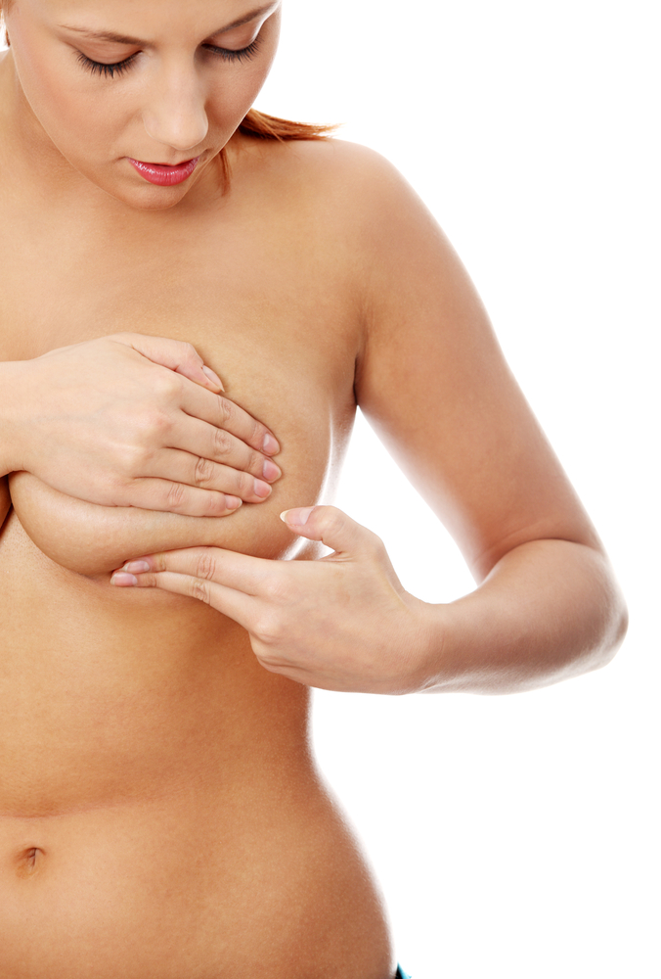
Getting to know your body:
Self-examination: checking my breasts

Slide 4


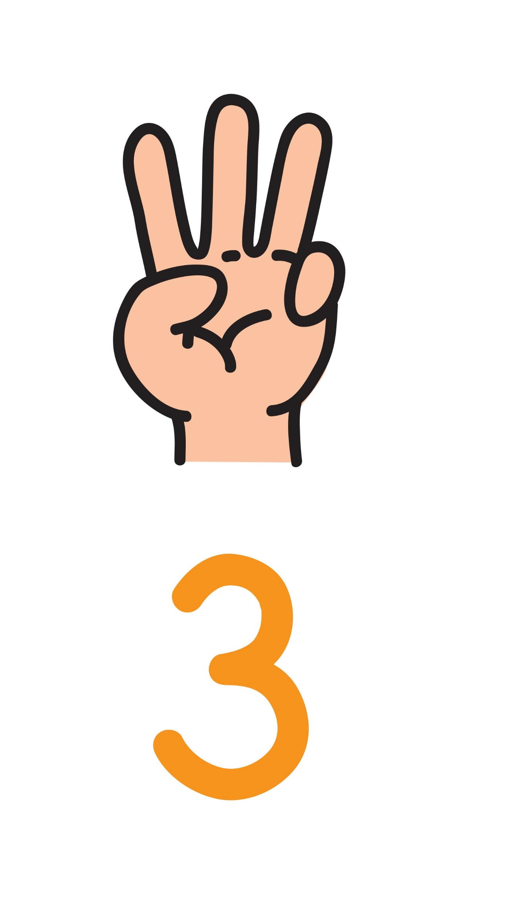
Getting to know your body: 5 things about your breasts
Your breasts change constantly throughout your life from puberty and through your adult life.
Everyone’s breasts look and feel different.
Some people have lumpy breasts, or one breast larger than the other, or breasts that are different shapes.

Slide 5
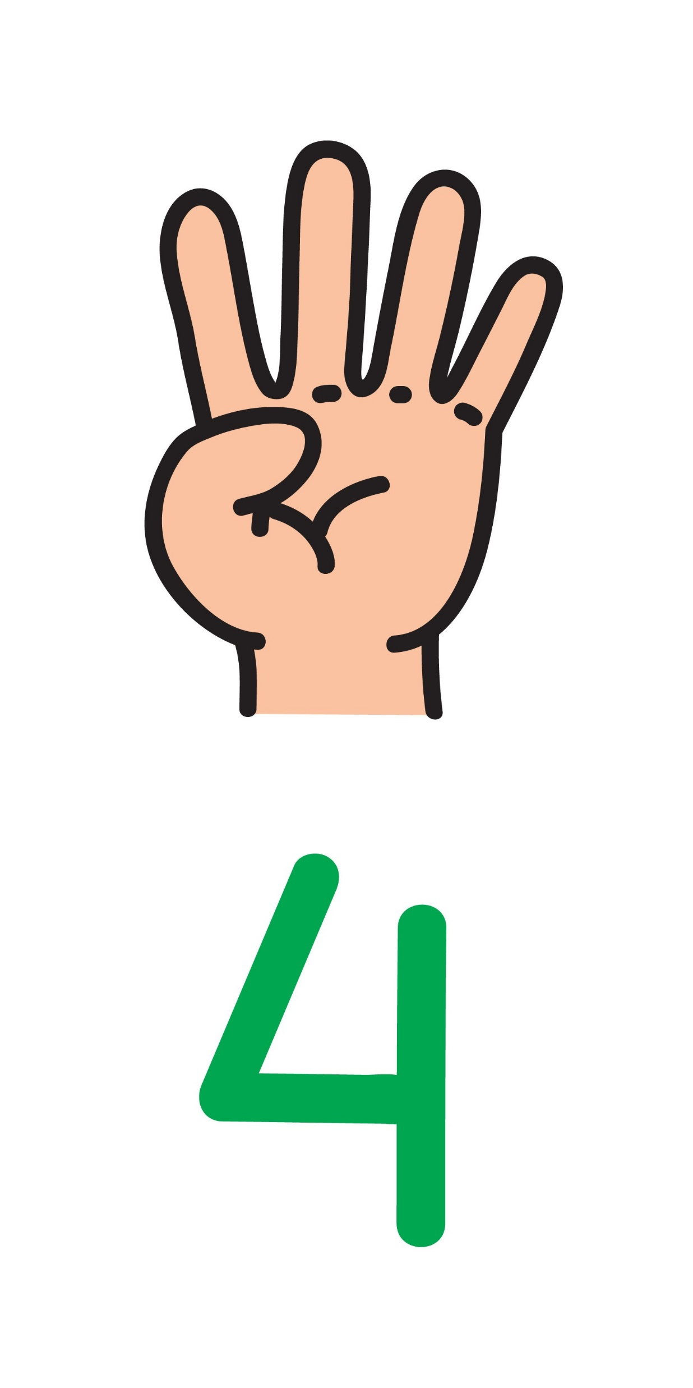
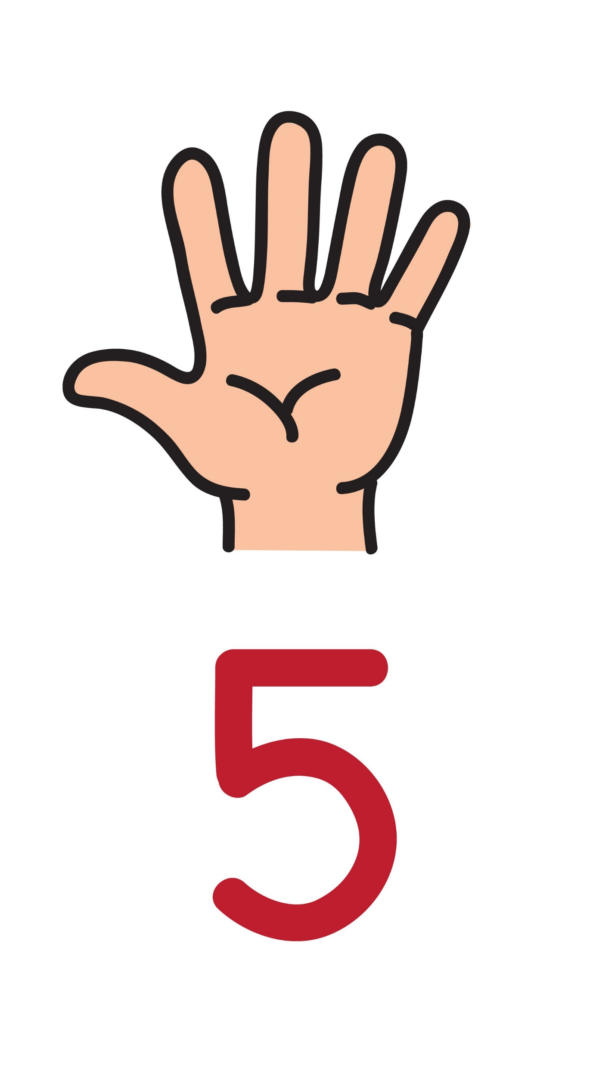
If you have periods your breasts may feel heavier and fuller before your period. Before or during your period they may be tender or lumpy. After a period, this usually lessens or disappears altogether, although some women have tender, lumpy breasts all the time.
When you check your breasts, try to be aware of any changes that are different for you. If something has changed or you have a worry about your breasts go to your GP. So get to know your breasts!

Slide 6

Self-examination - Here’s how to do it
Understanding your own breasts: Self-examination https://vimeo.com/261555966

Slide 7
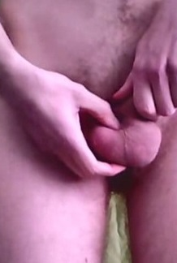
Getting to know your body:
Self-examination: checking my testicles image: https://commons.wikimedia.org/w/index.php?curid=35172108

Slide 8
Getting to know your body: 5 things about your testicles
Your testicles will grow in the early stages of puberty, between the ages of 10 to 13. As your testicles grow, the skin around the scrotum - the sac that holds the testicles - will darken, hang down, and begin to develop hair.
Everyone’s testicles look and feel different.
Don't worry if one testicle is bigger than the other or if one hangs lower than the other. That’s normal.

Slide 9
If you have any pain or swelling around your testicles you should go to the GP.
It is important to know how your testicles usually look and feel. That way, you can spot any changes that are different for you. If something has changed or you have a worry about your testicles go to your GP. So get to know your testicles!

Slide 10
Self-examination - Here’s how to do it
How to perform a testicular self-examination: The Robin Cancer Trust https://youtu.be/NvDglB_HXyE

Slide 11
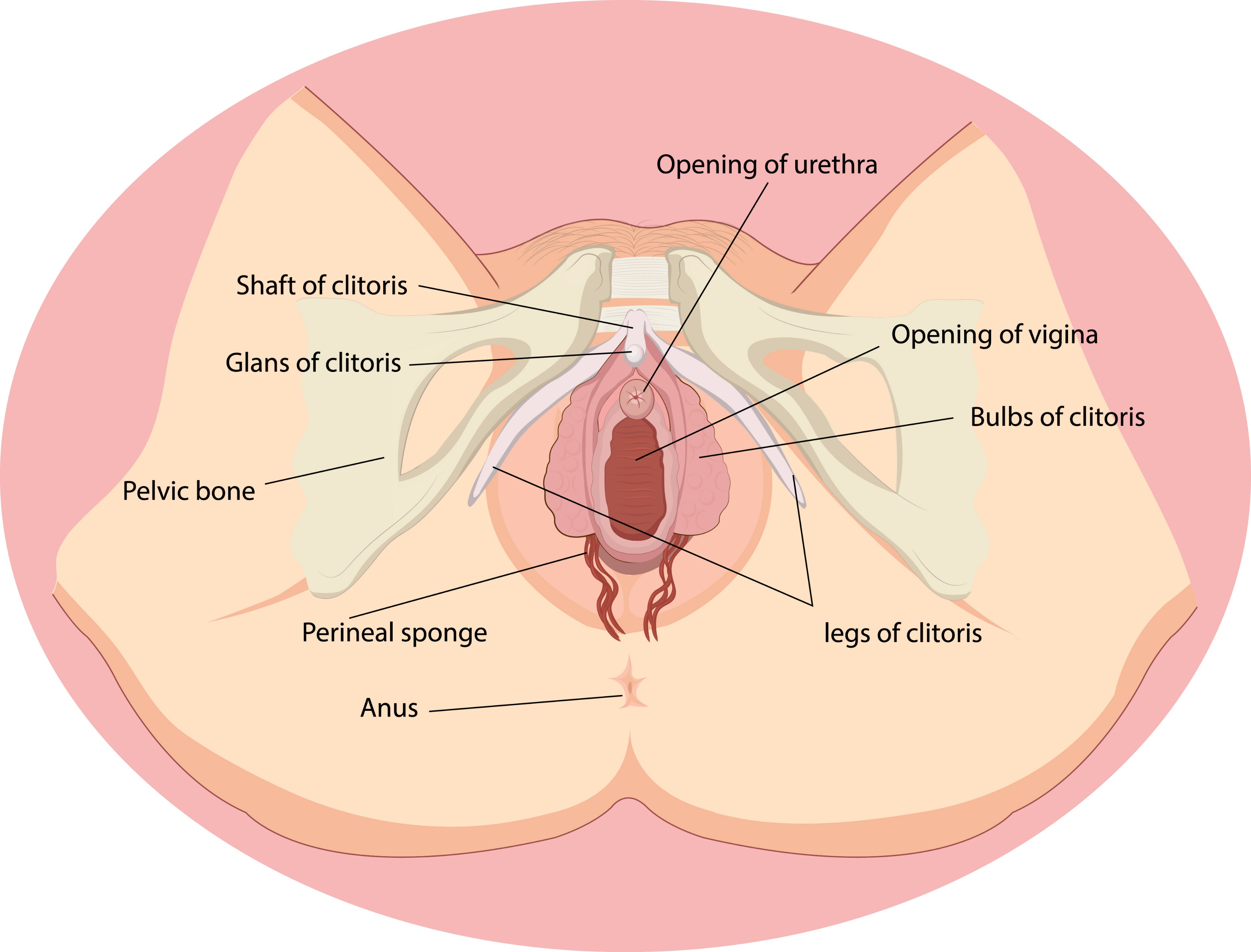
The clitoris and pleasure. Did you know?
The clitoris is an erectile hooded organ. It contains a high level of nerve endings and is sensitive to stimulation.
It is responsible for stimulating female orgasm.
It is the only organ in the human body that exists exclusively for pleasure.
The clitoris has erectile tissue that swells when aroused. The clitoris’ blood supply enables it to engorge continuously — allowing anybody with a clitoris to experience multiple orgasms.
When a female has an orgasm, this typically lasts longer than the male, at an average of 13-51 seconds.

Slide 12
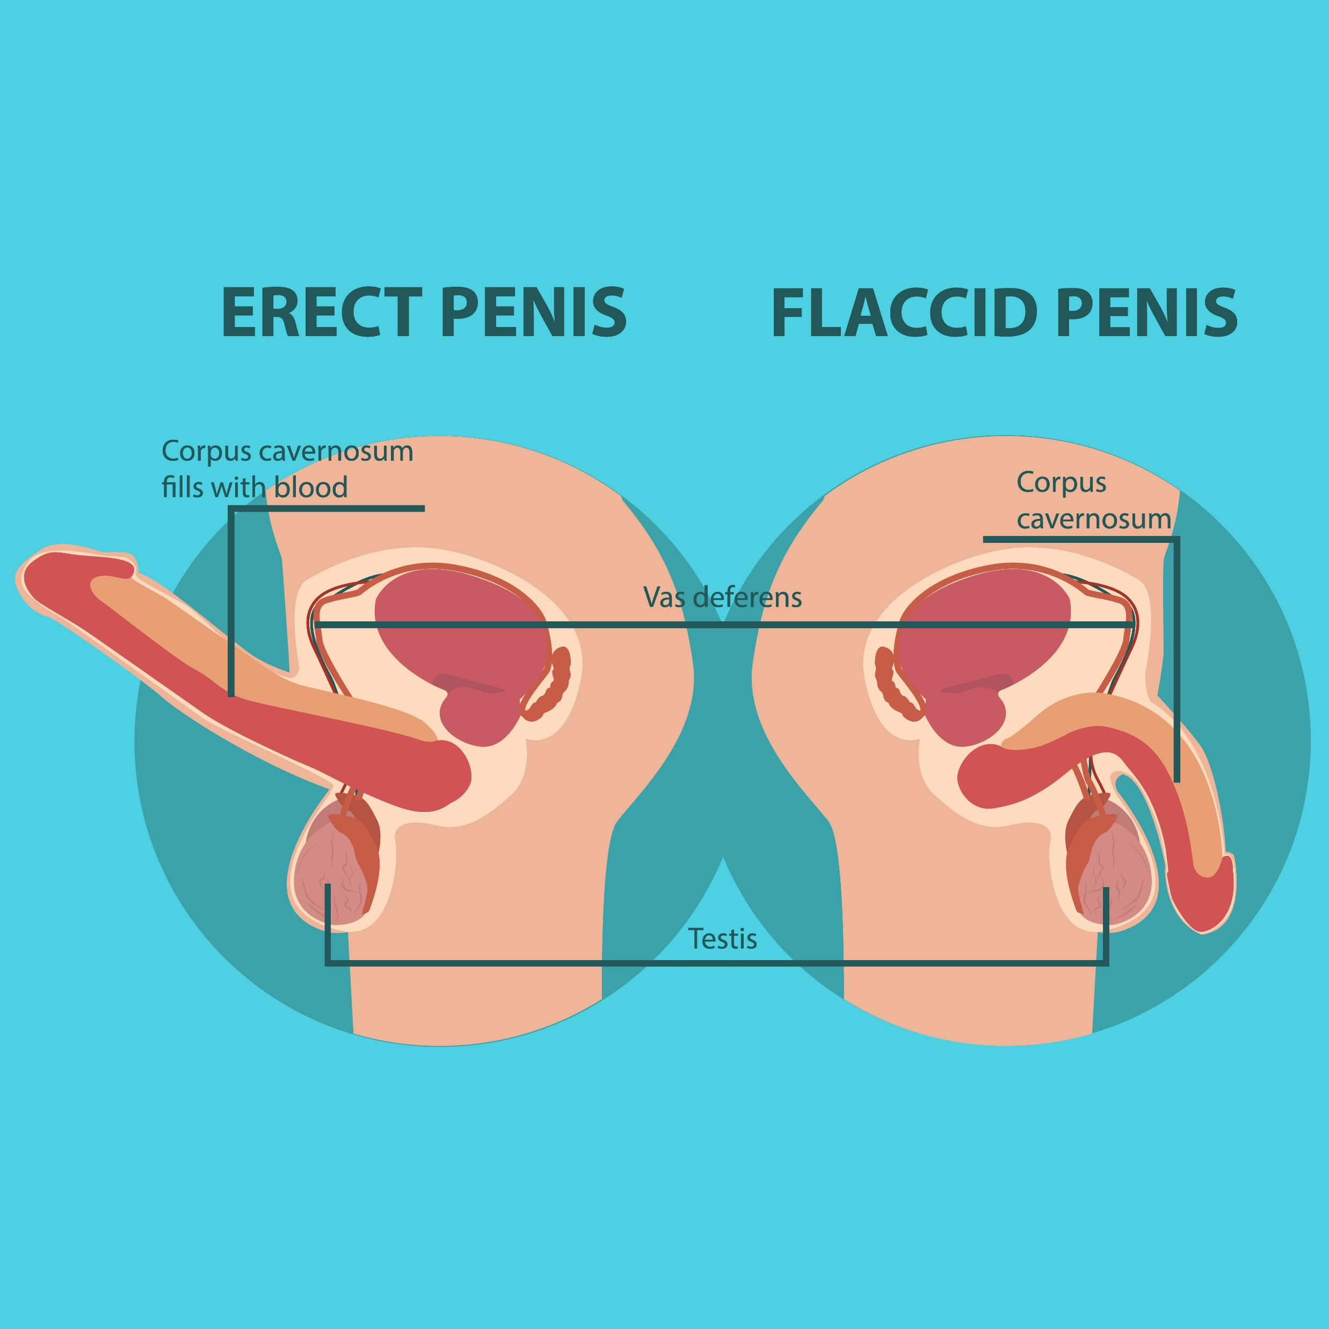
The penis and pleasure: Did you know?
When a man is stimulated physically or psychologically, he gets an erection. Blood flows into the corpora - the spongy tissue running the length of the penis - causing the penis to grow in size and become rigid. The testicles are drawn up toward the body as the scrotum tightens.
Many men consider the underside of the glans (head) of the penis and the underside of the shaft to be most sensitive to sexual pleasure.
The average male orgasm lasts for 10-30 seconds.

Slide 13

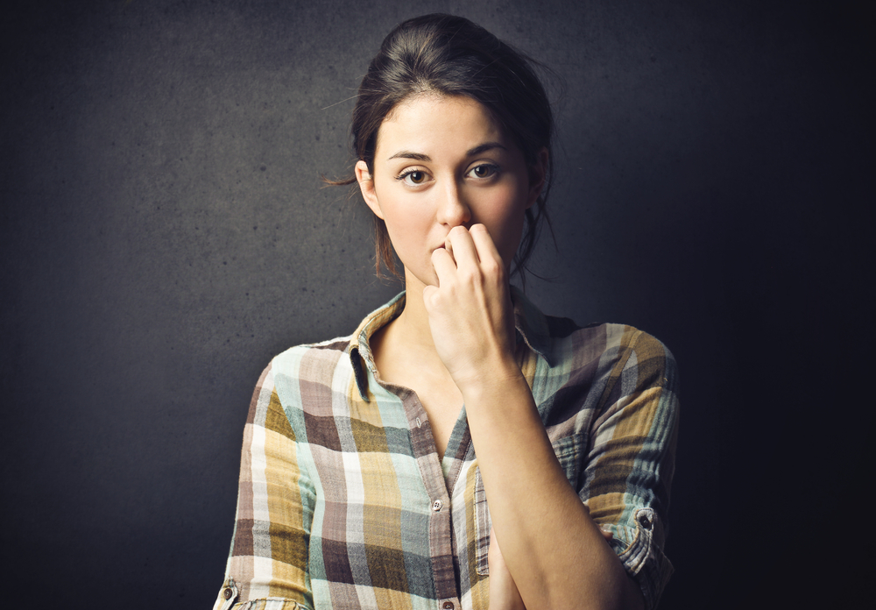
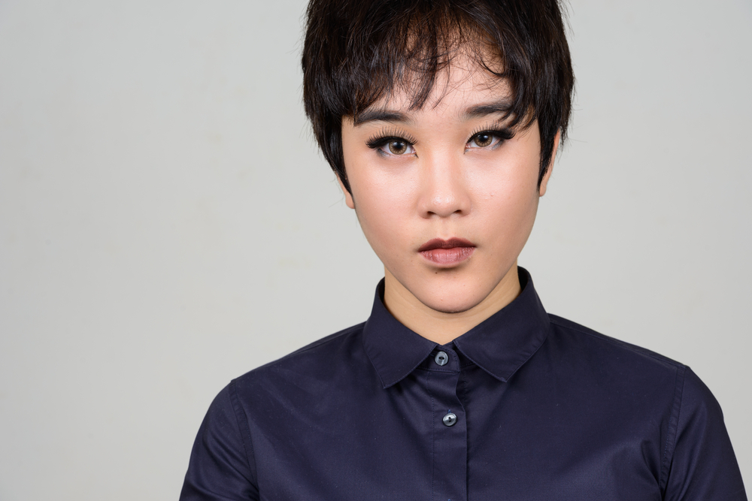

Many people have problems with sex at some stage in their life.
To understand the reasons behind any problem, both physical and psychological factors have to be considered, including the person’s relationship with a partner.
Sexual problems can affect any person - straight, gay, lesbian, bisexual or transgender.

Slide 14
Sexual problems
Discuss the set of cards with the different problems explained.
Remember any questions or points you want to make when we get back together to talk.

Slide 15
Things to remember
Spend time getting to know your body, especially breasts and testicles.
Spend time on all parts of your body, focussing on what feels good.
Get to know what is normal for you, and if something doesn’t feel right, if you are worried, if you have pain, speak to your GP or to someone at a sexual health clinic.

Slide 16
Things to remember
Sex should never be painful. It should not be distressing. If you experience pain or distress during sex please speak to your GP or someone at a sexual health clinic.

Slide 17




Insert local service information

