Slide 1
Stigma, taboo and discrimination
I understand that my actions and language impact on others.
I show respect for others.
I can describe and challenge stigma and discrimination.

Slide 2
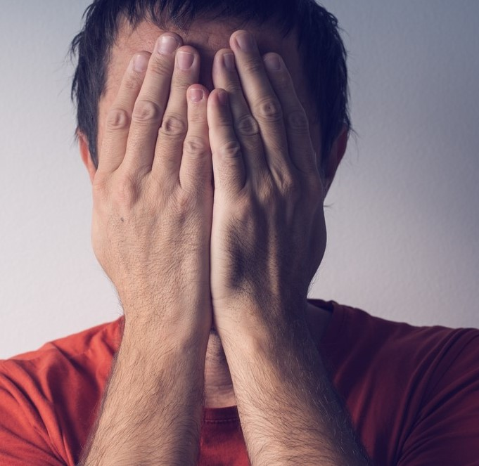
Stigma is a set of negative or unfair beliefs that people or a whole society might have about something. This can apply to health issues, so people might say there is a stigma about mental illness, or a stigma about people living with HIV.
When you experience stigma it can be someone judging you, being hostile towards you, physical or verbal abuse or being excluded or avoided.

Slide 3
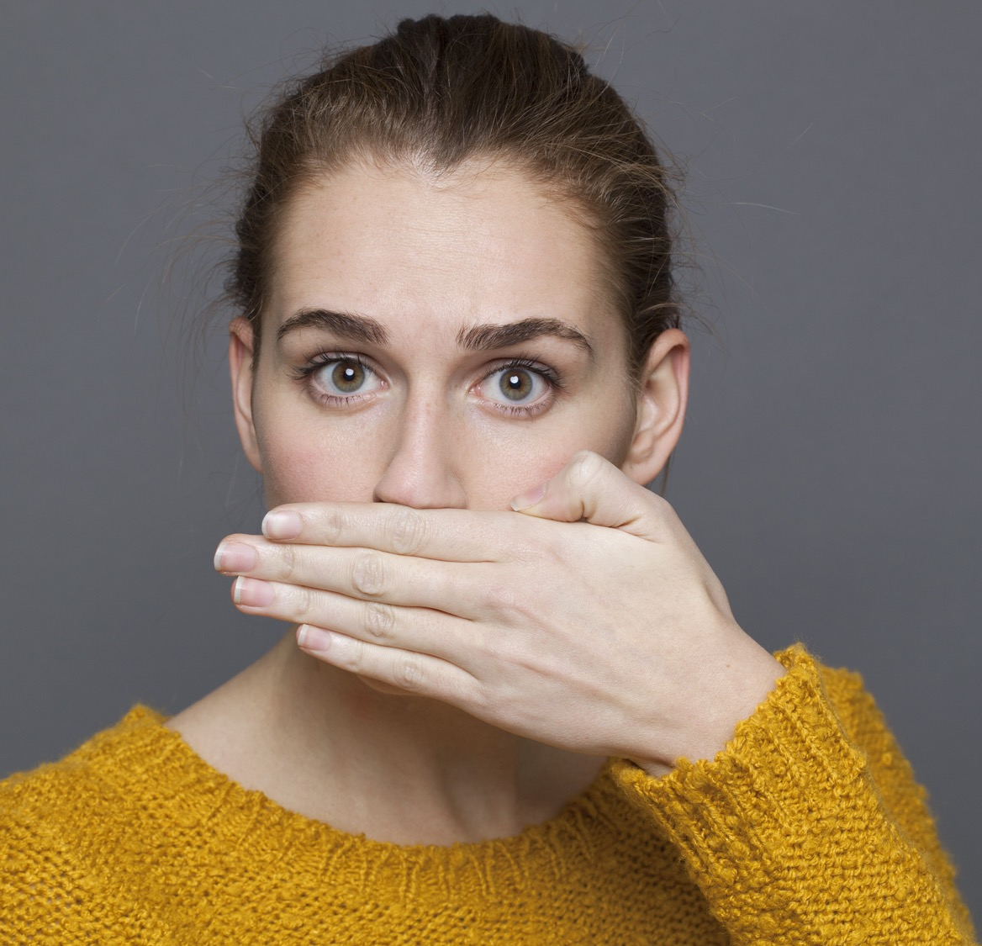
A taboo is something that is thought to be not acceptable to do or to talk about. It can be about a subject like sex or sexuality or sexually transmitted infections.

Slide 4
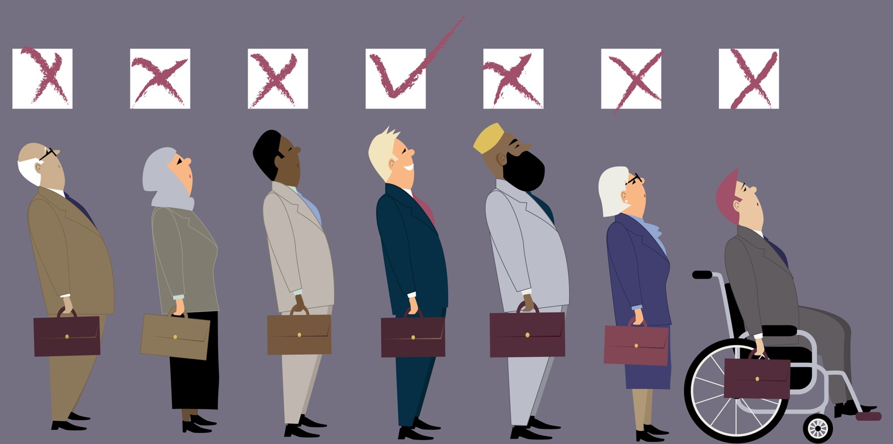
Discrimination is when someone treats you unfairly because of who you are. This could be because of your gender, sexuality or because you have a disability or health condition.

Slide 5
Which groups in society might experience stigma, taboo or discrimination?

Slide 6
Stigma and taboo:
Mental Health
One study of young people found that only 37% said they would tell someone if they were finding it difficult to cope with their mental health.

Slide 7
Film:
See Me: Talking about mental health
https://youtu.be/F9iLJa9ZdE4
(duration 3 minutes 48)

Slide 8
Stigma and taboo: Living with HIV
“I knew there was a stigma before I was diagnosed – I know HIV was a taboo, but it’s difficult experiencing it” Joseph Cotgrave on living with HIV
Film: Living with the stigma of HIV https://youtu.be/mdhEun0I-nM
(duration 6 minutes 48)

Slide 9
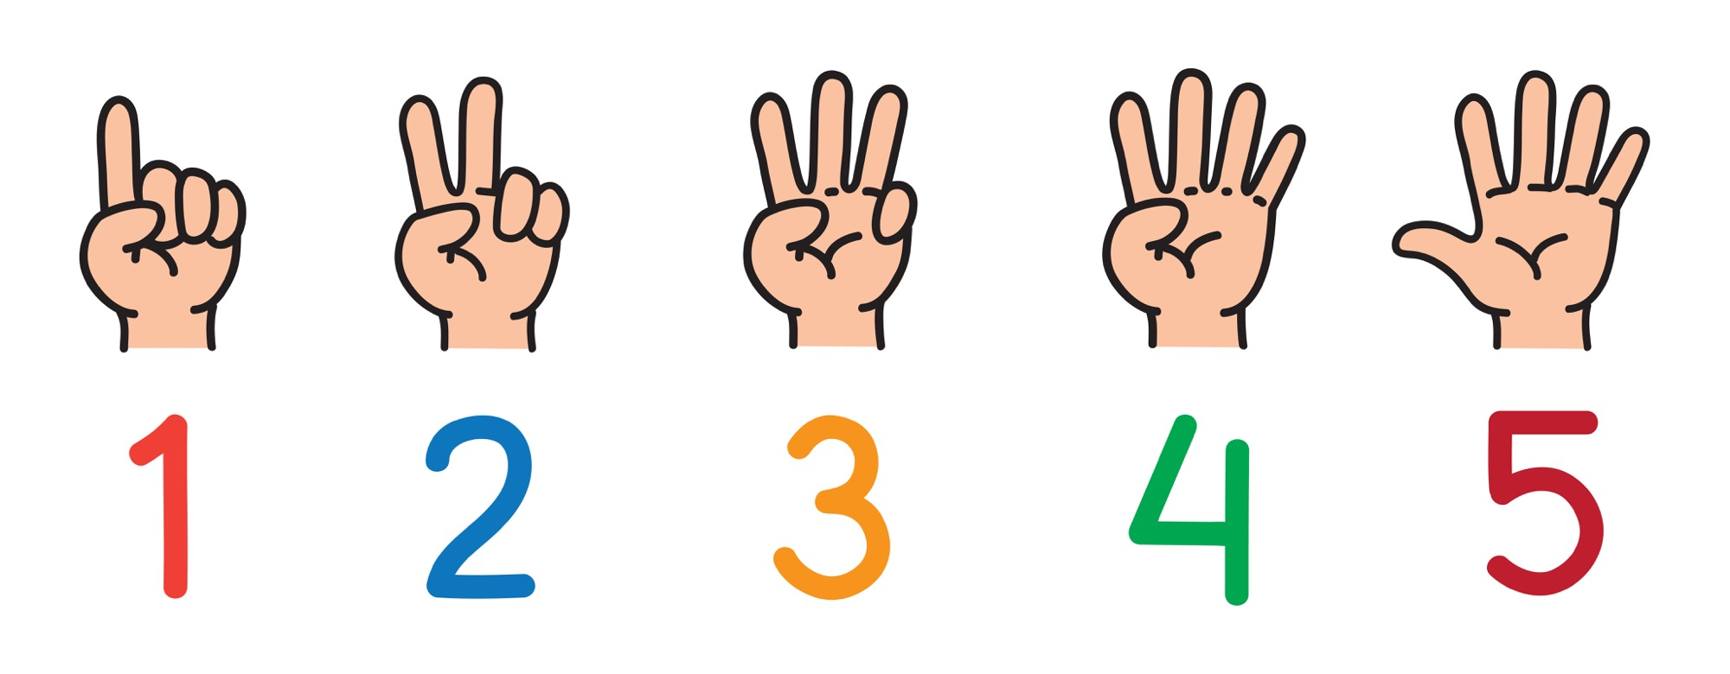
How can we fight against stigma and discrimination?
5 ways…

Slide 10
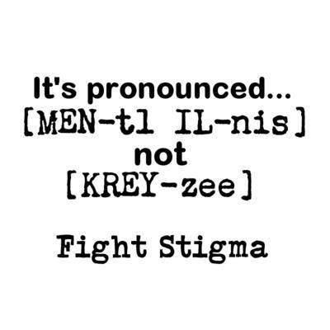
How can we fight against stigma and discrimination?
Know the facts.
Educate yourself and others instead of believing ‘fake news’.

Slide 11
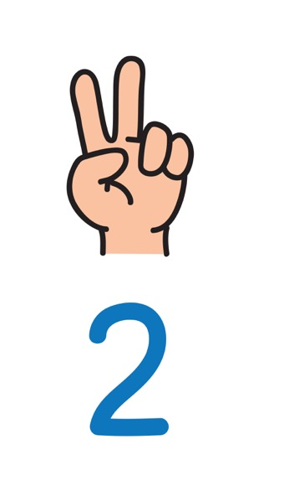
Be aware of your attitudes and behaviour.
We all grow up hearing or even learning prejudices and judgmental thinking. But we can change the way we think. We can choose to see people as unique human beings, not as labels or stereotypes.

Slide 12
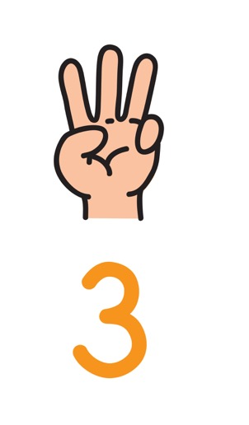
Choose your words carefully.
The way we speak can affect the way other people think and speak. We can decide not to use language that hurts or puts someone down.

Slide 13
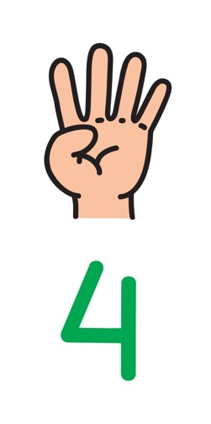
Support and include people.
Treat people with dignity and respect. Think about how you’d like others to act toward you.

Slide 14
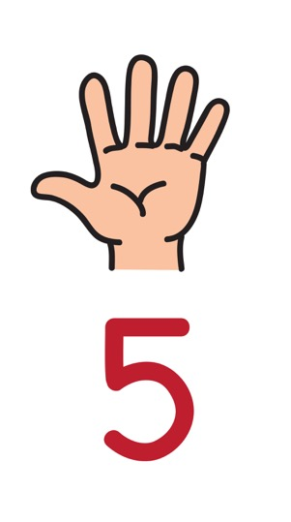
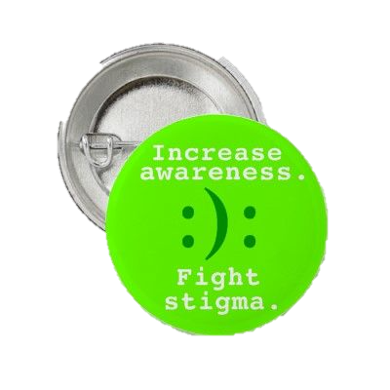
Use the law to protect people.
It is against the law to discriminate against people because of their gender, how they identity, their sexuality or sexual health status. It’s also not cool.

Slide 15
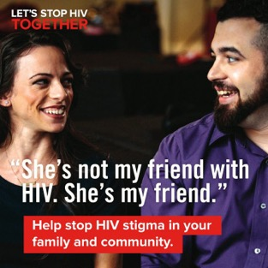
How can we fight against stigma and discrimination? Campaigning and educating…

Slide 16
U OK M8?
Short film about the social media campaign by LADbible.com
https://vimeo.com/234808377
(duration 1 minute 30)

Slide 17
The Stand Up Kid
(Time to Change UK)
https://youtu.be/SE5Ip60_HJk
(duration 3 minutes 7)

Slide 18
Sometimes we say we’re fine when we’re not
(Time to Change UK)
https://youtu.be/nOkH2jGK4p0
(duration 37 seconds)

Slide 19
Remember that ChildLine is for young people your age. There’s lots online and you can talk confidentially with someone https://www.childline.org.uk/

