Slide 1
Social Media: Fake News/Fake people
I can discuss my online life.
I understand that my online presence requires me to have strategies for safe use.
I recognise the presence of ‘fake news’ online.
I know that people can present themselves as friends yet become a threat to my safety and wellbeing.
I can identify sources of support.

Slide 2
Question:
How many hours a week do you spend online?
Less than 10 hours
Between 10 and 30 hours
More than 30 hours

Slide 3
Talking points
It is reported that teenagers can spend more than 30 hours a week online.

Slide 4
Question:
But what percentage of UK 15-year-olds are online more than 6 hours a day?
20%
33%
50%

Slide 5
Talking points
A third of UK 15-year-olds can be classed as ‘extreme internet users’ (6+ hours of use a day) much higher than other European countries.

Slide 6
Question
What percentage of adults check their phone within 5 minutes of waking up?
10%
25%
40%

Slide 7
Talking points
40% of adults check their phone within 5 minutes of waking up.

Slide 8
Social media can provide many benefits to young people, but along with that comes added pressure to live in the public eye, seeking reassurance through likes and shares, and exposure to content which could be harmful or upsetting.
Talking points
Are you happy with the amount of time you spend online?

Slide 9
UK Safer Internet Centre reports:
2 in 5 young people have seen fake news online.
More than half (54%) of 12-15-year olds get news online, the second most popular source of news after television (62%).
Most 12-15 year olds who follow news on social media are questioning the content they see. Most say they would make at least one practical attempt to check whether a news story is true or false.

Slide 10
How do you know if something is fake?
How can you check?
How to spot misinformation:
Full Fact Toolkit https://fullfact.org/toolkit/

Slide 11
Online grooming
Say No!
(duration 10 minutes 39) https://vimeo.com/251474753

Slide 12
Online grooming
Grooming is when someone builds an online relationship with a young person and tricks them into doing something sexual. This could be sexual conversations online or by text, sending naked images or videos, doing something sexual live on webcam or meeting up in person. If you send someone sexual photos or videos of yourself, you lose control over what happens to them. If this happens it’s never too late to put a stop to it. Speak to an adult you trust. Or contact ChildLine’s confidential help service.

Slide 13
Building confidence after online bullying
https://youtu.be/9HocoOVVUDY
(Duration: 2 minutes 52 seconds)

Slide 14
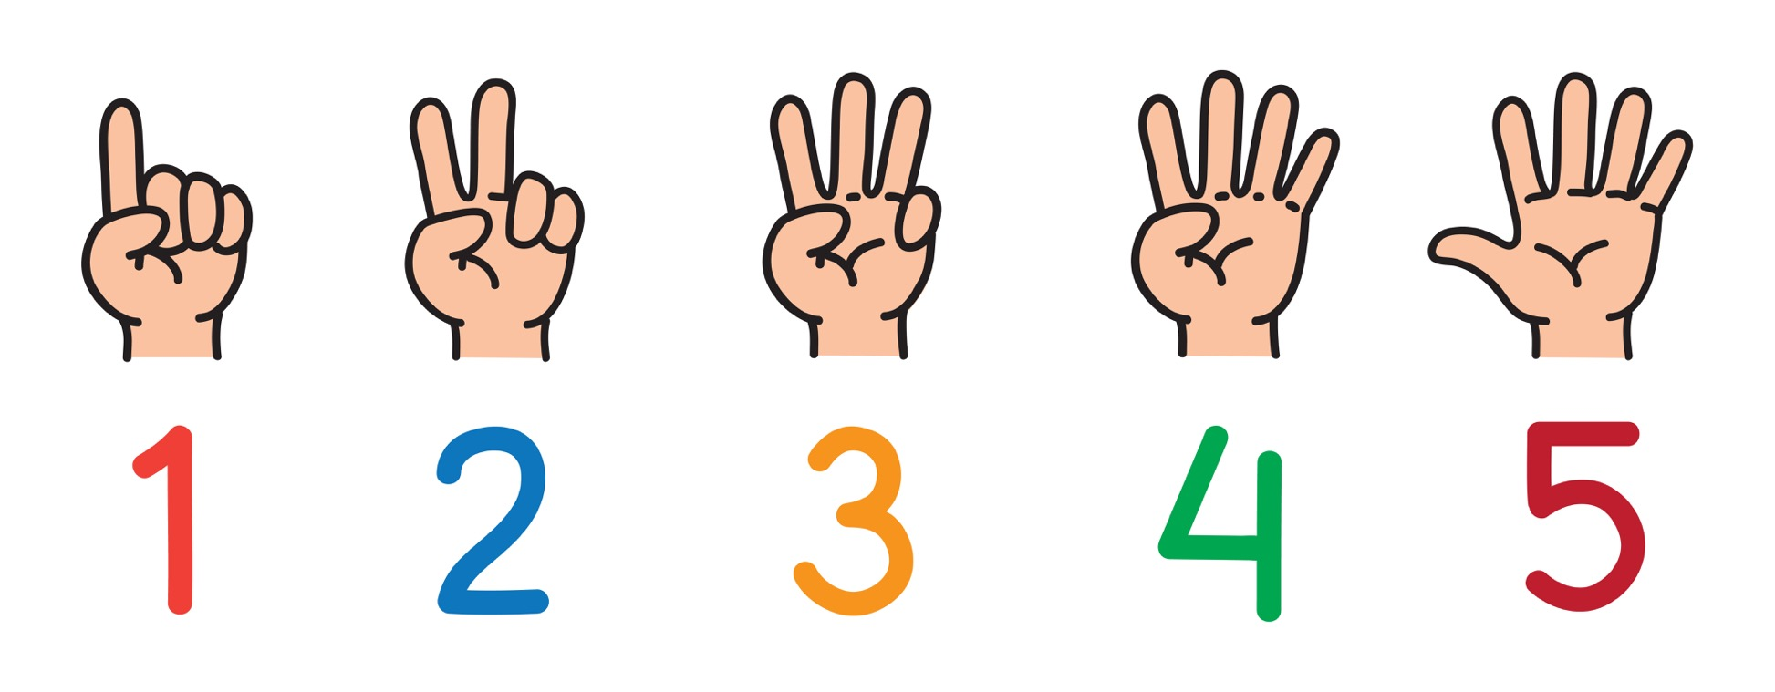
Work with a partner and think of 5 things you wish you had known about being online when you were younger.
Then 5 bits of advice you would give yourself now about living the best online life.

Slide 15
Online grooming
Listen to your selfie https://youtu.be/TcMd468Pqbs
(3 minutes 16 seconds)

Slide 16
Information and advice:
https://www.childnet.com/young-people/secondary
ChildLine
www.childline.org.uk
If you're under 19 you can confidentially call, email or chat online about any problem big or small
Chat 1:1 with an online advisor

