Slide 1
How do you know you are ready for sex?
I can describe what the good relationship would mean for me.
I am building skills and confidence to make decisions about my own personal relationships, including sexual relationships.

Slide 2
What are the most common questions young people have about having sex for the first time?

Slide 3
How do you know if you are ready to have sex for the first time?
https://youtu.be/BrUMvQjEkvo

Slide 4
Top 10 questions about the first time

Slide 5
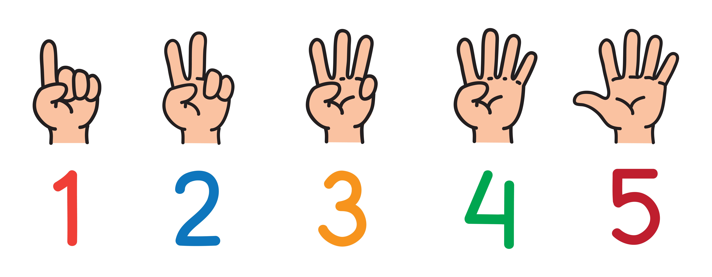
So, how do you know if you are ready to have sex?

Slide 6
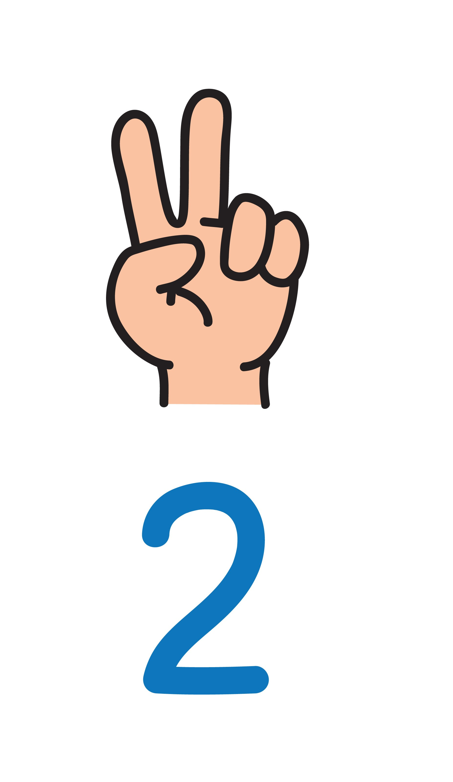
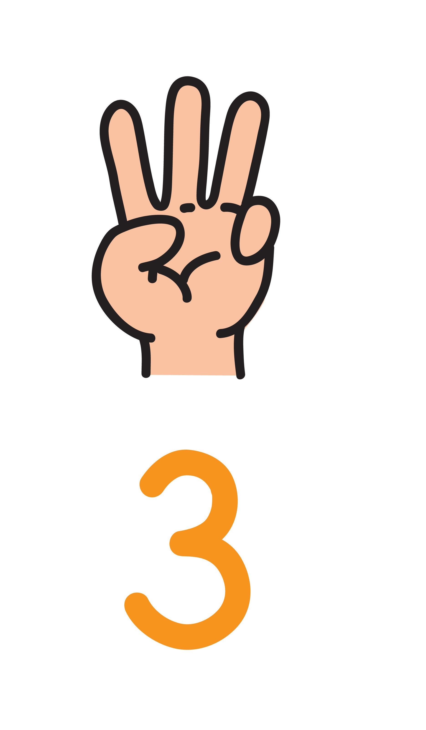
So, how do you know if you are ready to have sex?
You know your partner. You both respect each other. You have talked about it. You are at the same stage in the relationship. You are both ready.
You feel emotionally ready. Sex is an emotional thing. If you don’t feel ready, you’re not, so wait.
Your body just feels ready. You never want to rush into it or feel pressured.

Slide 7
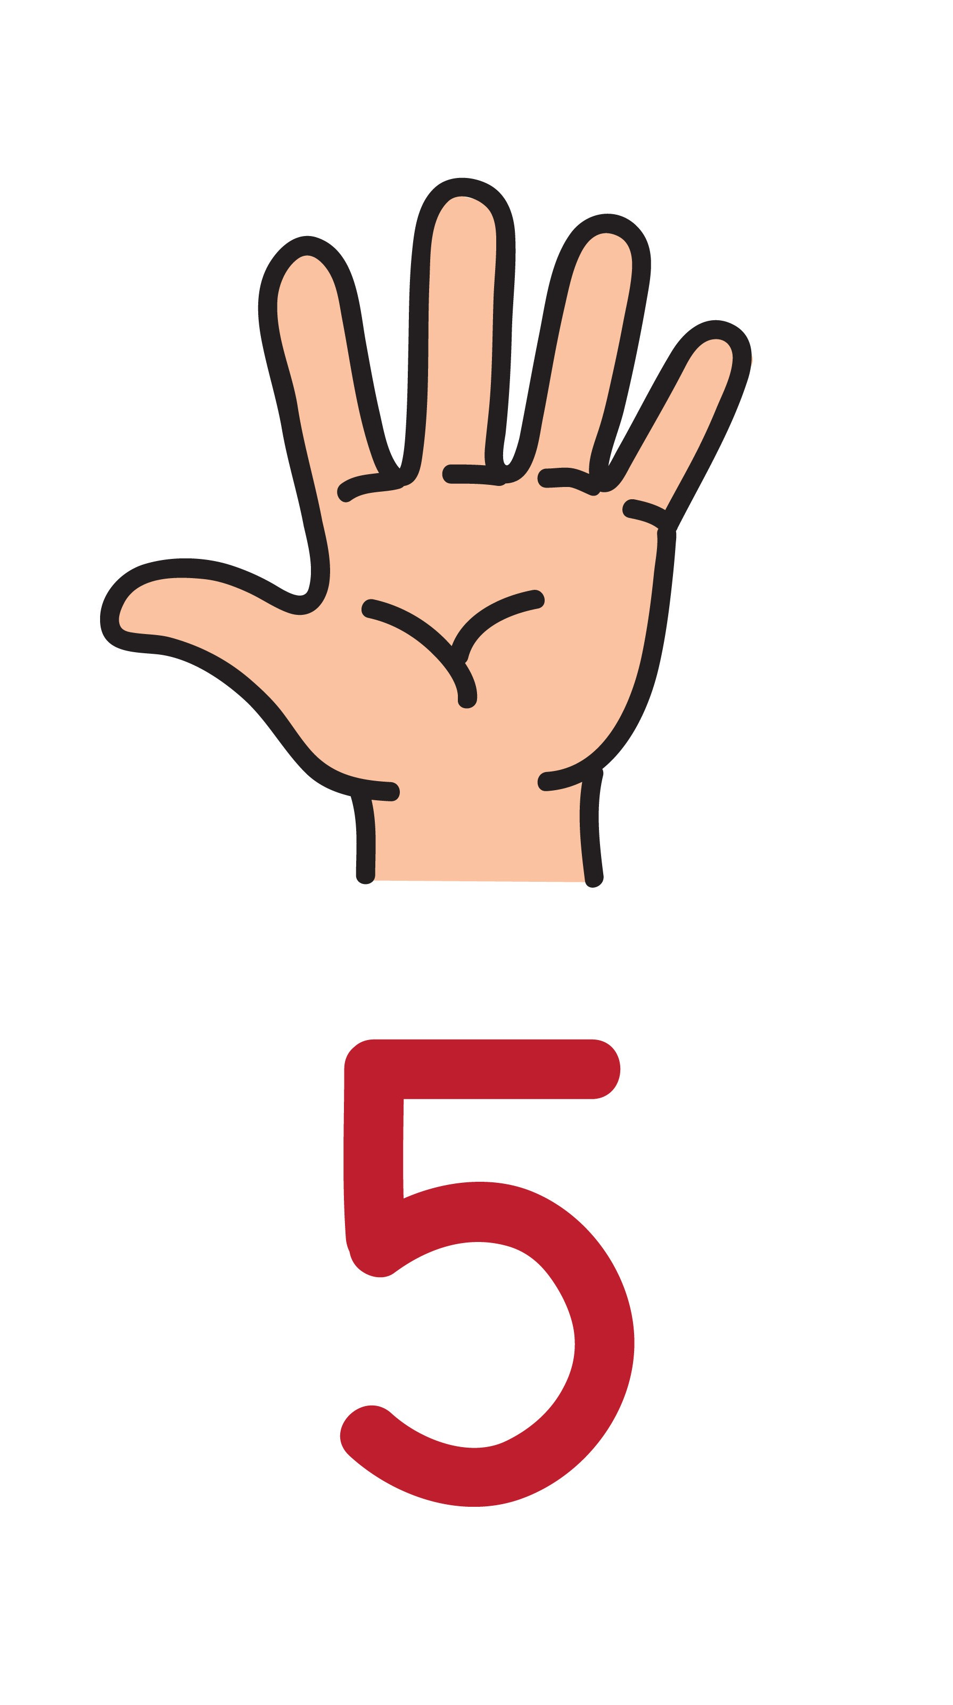
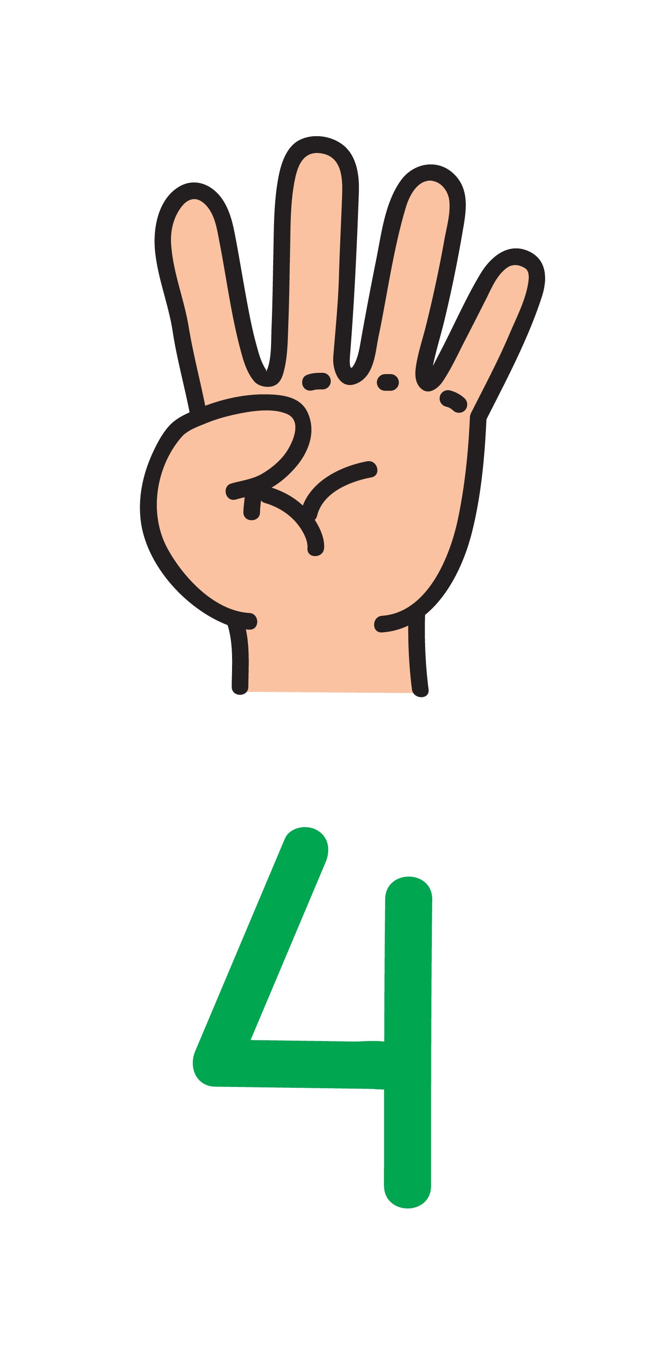
You are doing it because you really want to. Don’t give in to peer pressure, or pressure from a partner, and don’t believe that everybody else is doing it so you have to. Take a moment and think about this: if you decide you don’t want to have sex just now, will your partner be okay with that?
You have got condoms and contraception sorted. Yes, both. So that you are both protected from STIs and for heterosexual couples there is no risk of pregnancy.

Slide 8
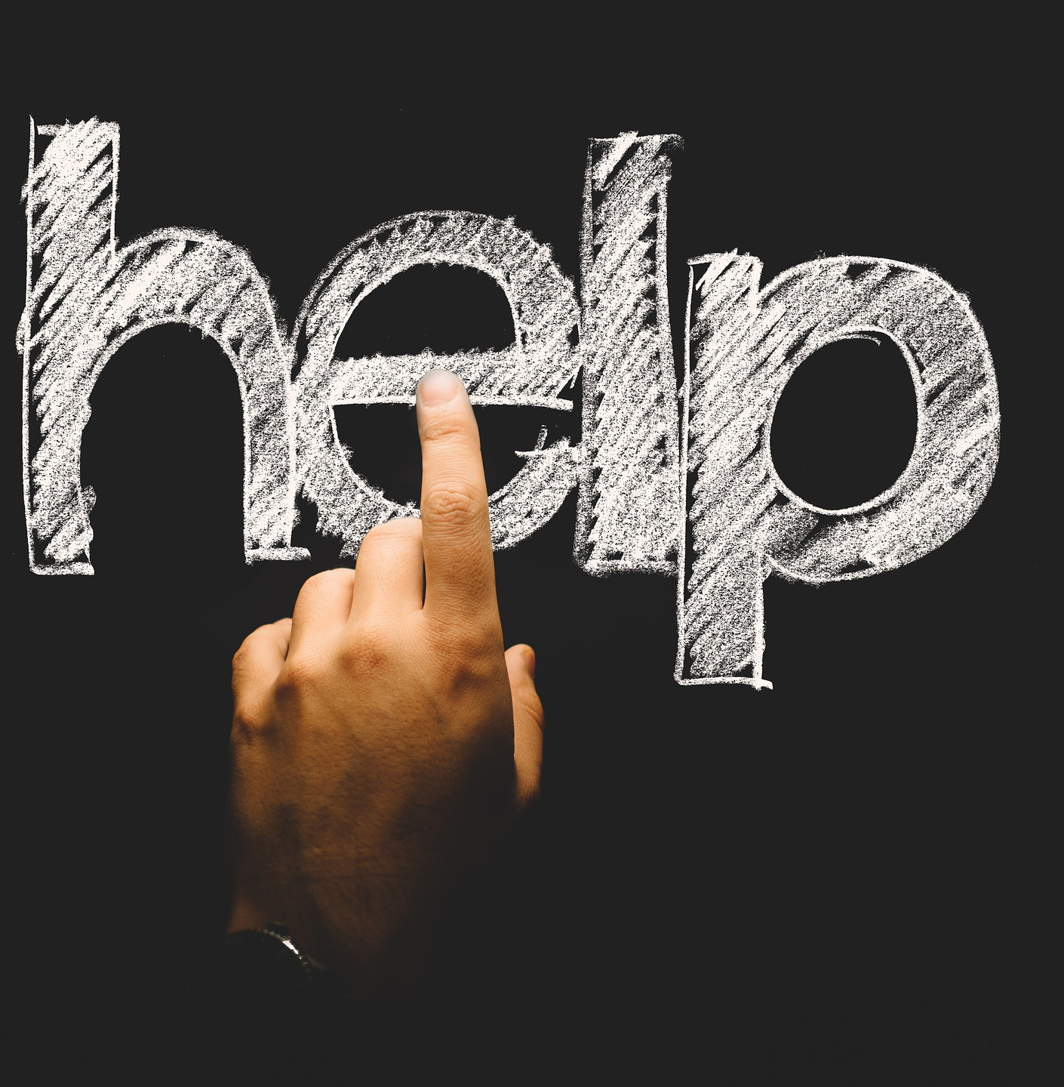
Finding good information, advice and support about sexual health, including condoms and contraception.
Here are some good sources of information online:
www.healthyrespect.co.uk
http://www.cool2talk.org/
http://youngpeoples.sandyford.org/
Your nearest confidential clinic that welcomes young people is:
INSERT LOCAL INFORMATION

