Slide 1
People who help me and look after me: When I have a question or a worry
I can identify the adults in my life who care for me and look after me.
I can talk about how adults care and look after me.
I can name who I can go to with a question or a worry.

Slide 2
If you have a question you want to ask about something important who do you go to?

Slide 3
What kind of things can children worry about?

Slide 4
Sometimes when a child has a worry they find it difficult to tell someone.
Why do you think that is?

Slide 6
Jenny had a lot of things she was worried about didn’t she?
She felt better after talking to her Gran.
Its always good to talk to someone if you have a worry. This could be someone in your family. Or you can talk to me or another adult in school.

Slide 7
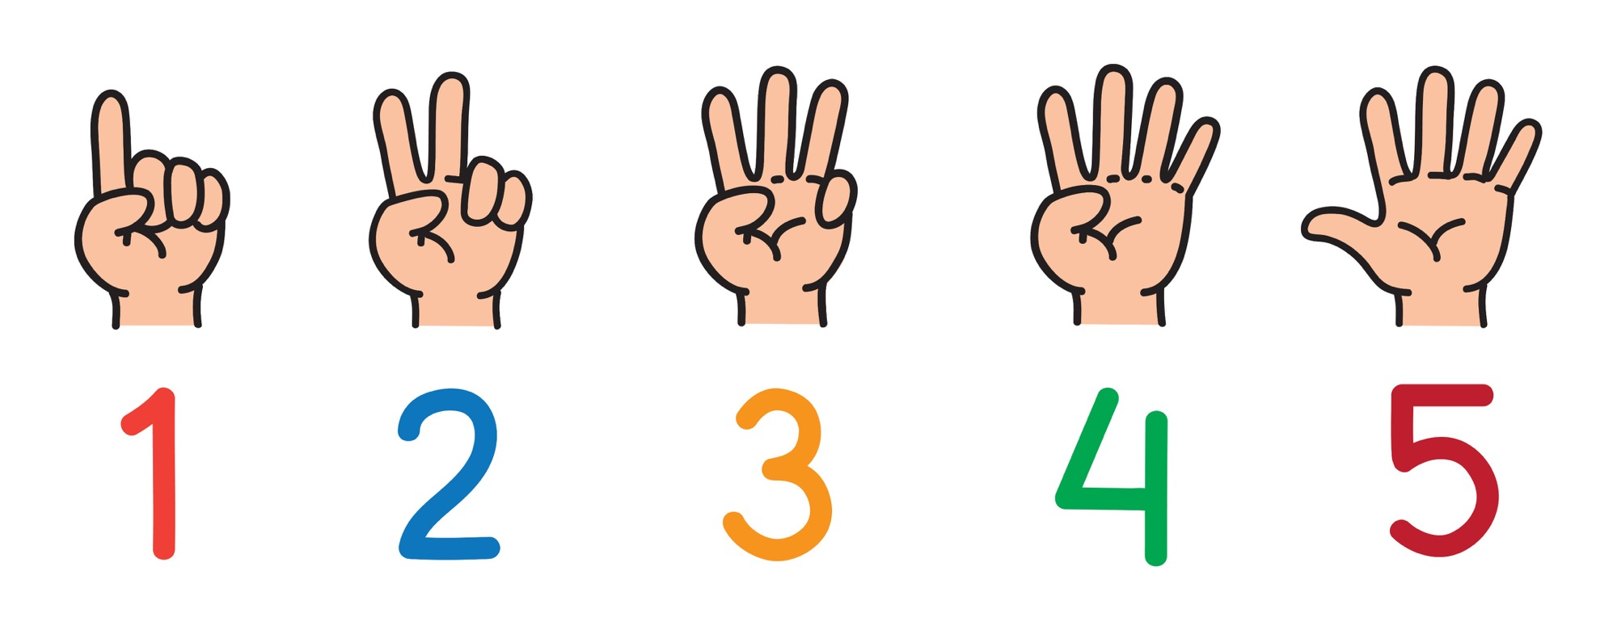
Who can I talk to?

