Slide 1
My senses: Things I like/Things I don’t like
I can identify and communicate about what I like and don’t like.
I know that I, and others, can use words, body language and facial expression to communicate what they like and don’t like.
I explain the idea of personal space.
I understand that other people might not like what I like, or dislike what I dislike.

Slide 2
Smell

Slide 3
Sight

Slide 4
Hearing

Slide 5
Touch

Slide 6
Taste

Slide 7
Things we like
Things we don’t like

Slide 8
Personal space
The bubble game

Slide 9
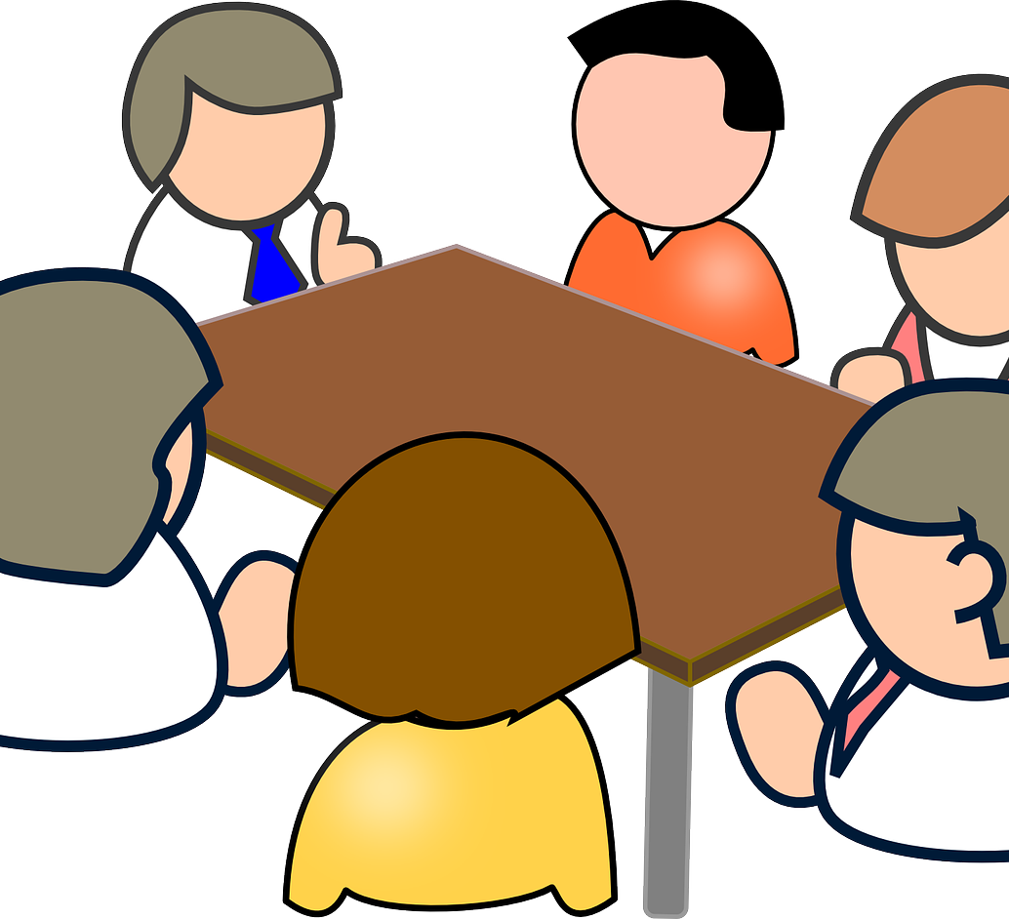
Activity Expert Panel of sense investigators

Slide 11
I like…
I don’t like…

Slide 12
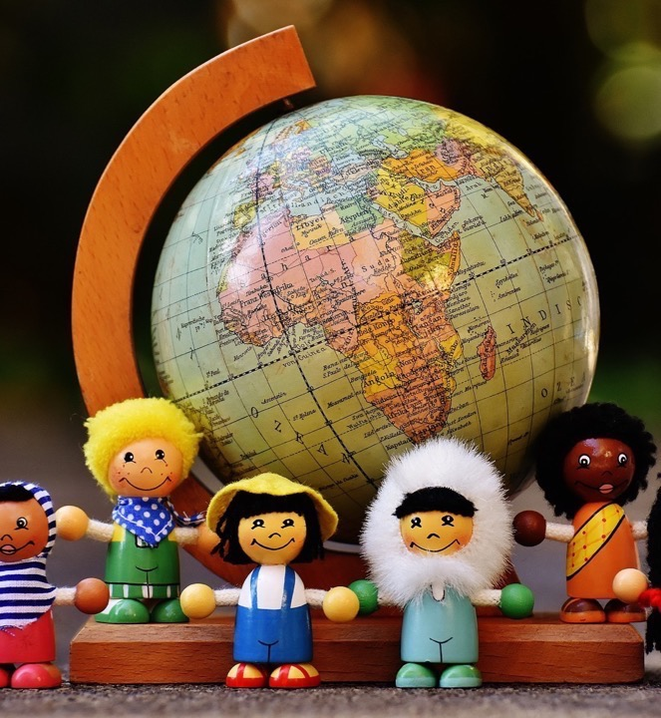
In this class, we are all individuals, different, unique and special.

