Slide 1
How adults plan and prevent a pregnancy: contraception and condoms
I can explain what contraception is used for.
I can explain what a condom is used for.

Slide 2
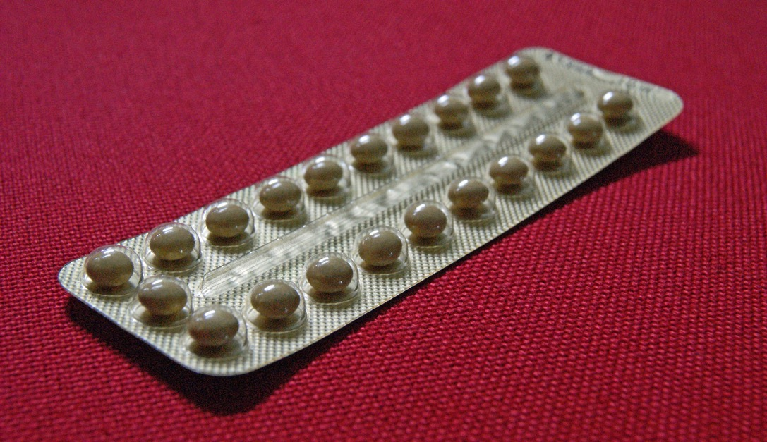
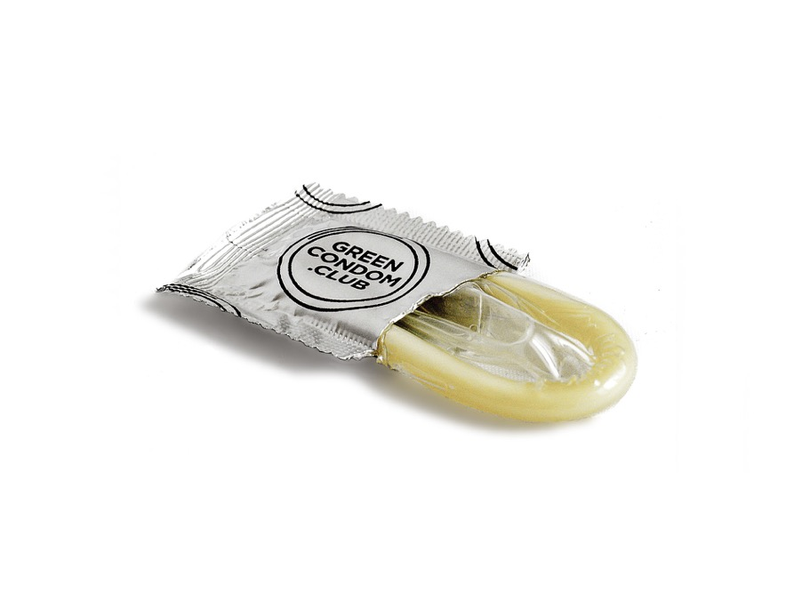
Contraception and Condoms

Slide 3
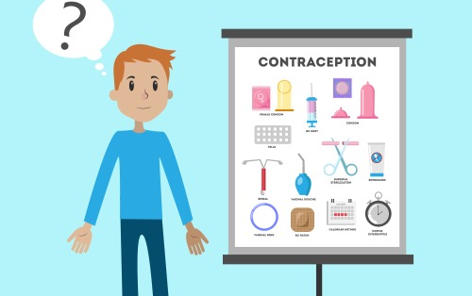
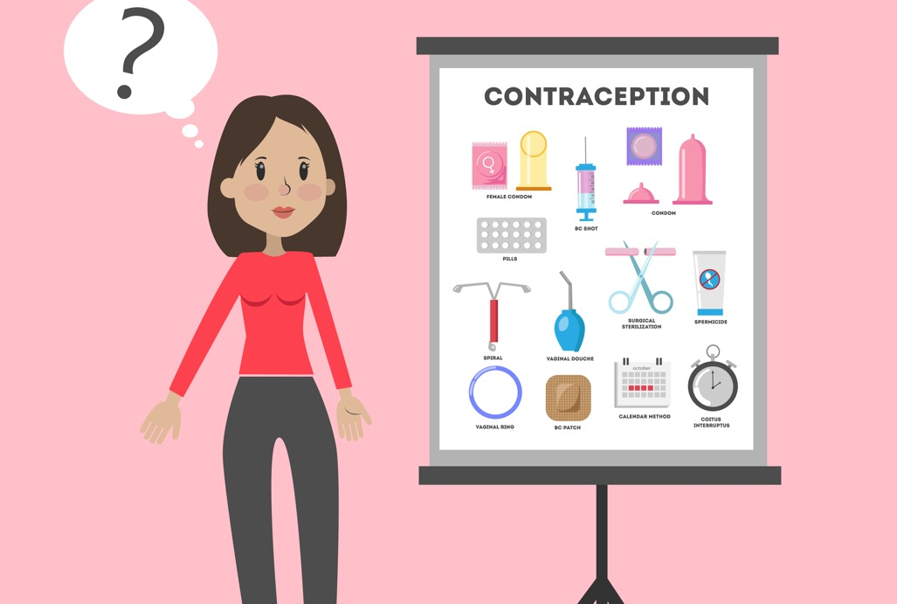
Why do people use contraception?
When a man and woman have sex, the man ejaculates sperm in to the woman’s vagina.
If the sperm meets the woman’s egg, she may become pregnant.
If a woman and man are having sex but don’t want to have a baby, then they can use contraception.
The woman and man can talk about what kind of contraception will work best for them.

Slide 4
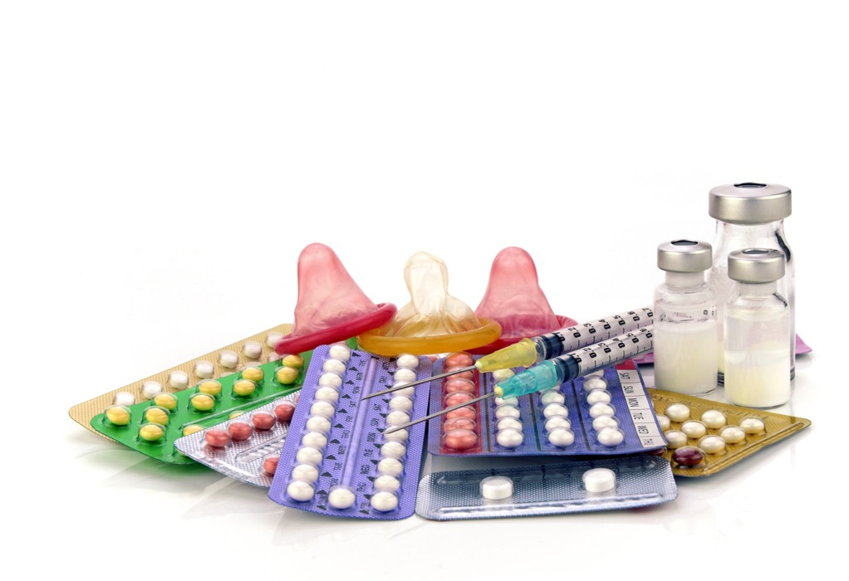
There are lots of different kinds of contraception that a woman can use.
A woman can take a pill, have an injection or have a little implant put just under the skin on her arm.
All these things are a medicine that stop the woman from becoming pregnant.

Slide 5
There is only one type of contraception a man can use.
It is called a condom.
A man fits the condom over his penis when it is erect.
During sex, his sperm comes out when he ejaculates. The sperm collects in the condom instead of going into the woman’s vagina.
So the sperm cannot meet the egg.

Slide 6
There is also a condom for women.
A female (woman’s) condom fits inside her vagina.
During sex, the man’s sperm comes out when he ejaculates. The sperm collects in the condom.
So the sperm cannot meet the egg.

Slide 7
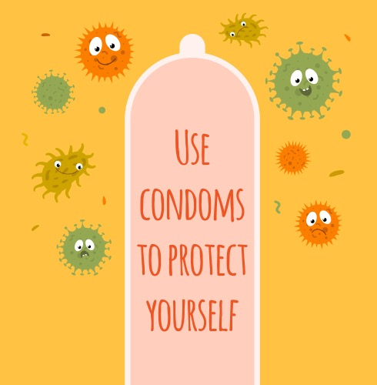
Condoms offer protection too.
If an adult has an infection called a sexually transmitted infection (STI) it can be passed on to another person when they have sex.
If a man or woman uses a condom this protects them from the STI.

